Slide 1
Team Laxmi Auto
Pune Institute of Computer Technology
Chinmay Patil, Nimish Mishra, Tejas Thorat

Slide 2
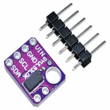
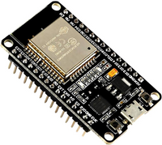
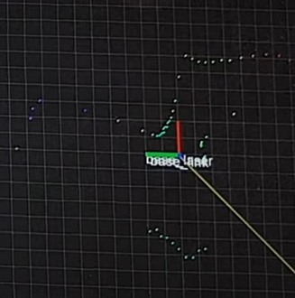
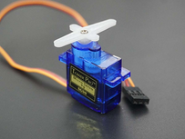
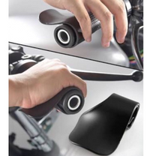
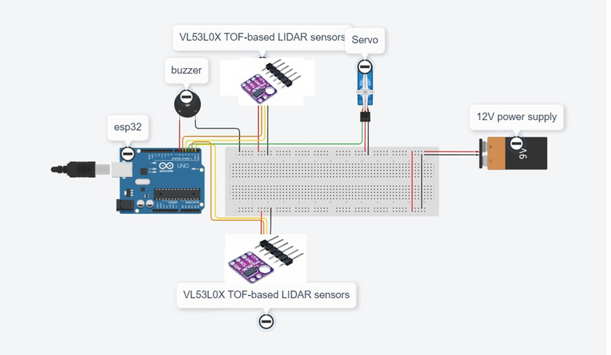
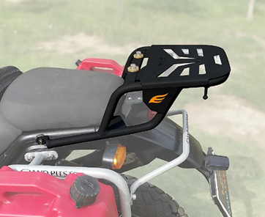
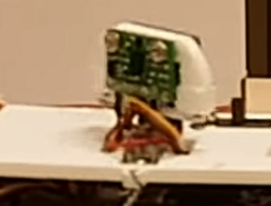
Design Overview:
The proposed solution utilizes two VL53L0X Time-of-Flight (TOF) based LIDAR sensors mounted on a rotating servo motor to create a 300-degree point cloud around the two-wheeler. This point cloud data is then processed to detect obstacles, and haptic and audio alerts are provided to the rider accordingly.
Major Components:
1)Two VL53L0X TOF-based LIDAR sensors
2)ESP32 microcontroller
3)Servo motor
Hardware Interface:
1)Connection of the LIDAR sensors and servo motor to the ESP-32 ensuring proper power supply and signal connections using soldiered jumper cables.
2)Setting of fixed PWM output to control the servo motor's rotation angle and speed to obtain optimal results.
Point Cloud Generation:
1)Rotation of the servo motor in fixed increments and collect distance measurements from both TOF sensors at each angle in real-time.
2)Combining the distance measurements from both sensors we can create a 300-degree point cloud representation of the surrounding environment.
Alert Mechanisms:
1)Haptic Feedback: Activation of the vibration motor to provide haptic alerts to the rider when obstacles are detected. Vibration intensity will be proportional to the proximity of the obstacle.
2)Audio Alerts: Using a buzzer or speaker to emit audible alerts, indicating the presence and location of obstacles using surround sound.
Major Components
Point Cloud Generation
Hardware Interface
Mounting Configuration

Slide 3
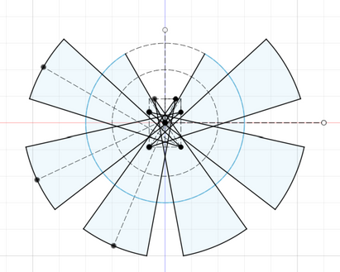
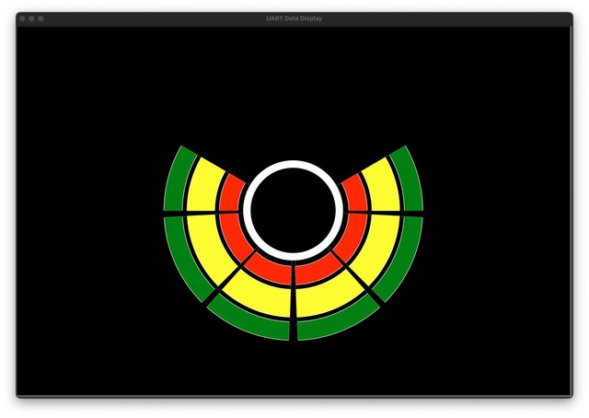
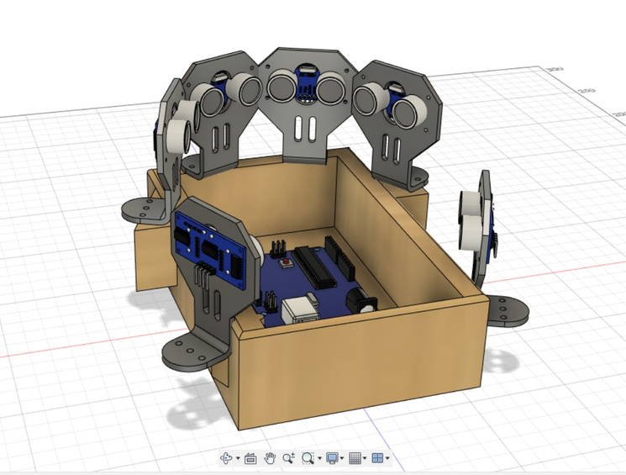
Concept :
Asynchronous Reading of array of ultrasonic sensor data using pin change interrupt
Detects multiple objects in range
Enhanced Visual Feedback on rider’s dashboard
Exact Calculation of Range and blind spots of ultrasonic sensors
Surround awareness :
Positive Use Case:
A rider intends to change lanes but is unaware of a vehicle in their blind spot.
Low Visibility Conditions : Fog, heavy rain, or other adverse weather conditions or road with less lights.
Failsafe Scenario:
1. Too small objects in blind spots
Ranging and Blind spots
Display on Rider’s Dashboard
Product

